Slide 1
IPCC
Intergovernmental Panel on Climate Change

Slide 2
The Intergovernmental Panel on Climate Change (IPCC) is the leading international body for the assessment of climate change.
It was established by the United Nations Environment Programme (UNEP) and the World Meteorological Organization (WMO) in 1988 to provide the world with a clear scientific view on the current state of knowledge in climate change and its potential environmental and socio-economic impacts
The IPCC reviews and assesses the most recent scientific, technical and socio-economic information produced worldwide relevant to the understanding of climate change.

Slide 3
IPCC don’t collect data
IPCC collate research from scientific experts
The authority on climate change science
5 reports: FAR (1990), SAR (1995), TAR (2001), AR4 (2007), AR5 (2014)

Slide 4
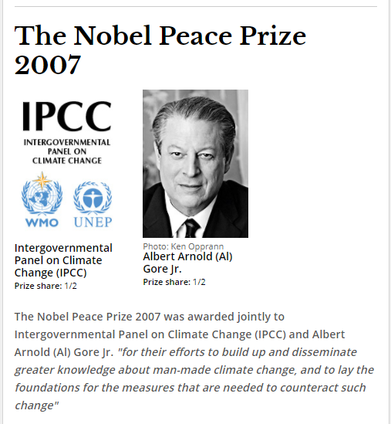

Slide 5
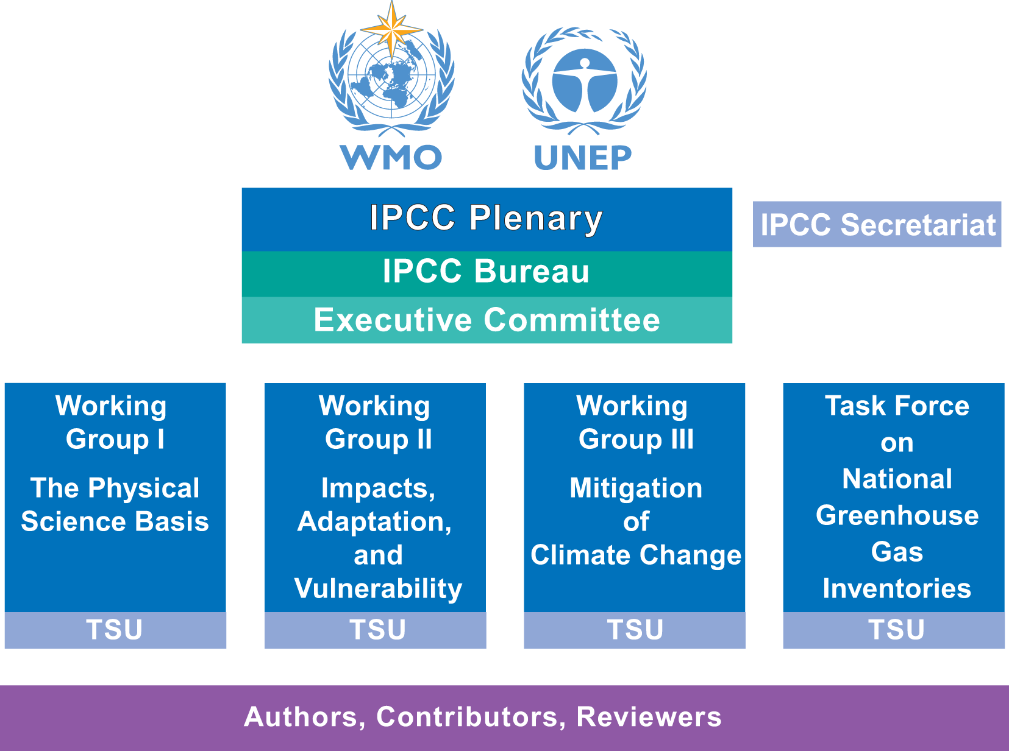

Slide 6
Writing and review process
of the IPCC assessment reports
Experts review the first draft of the report
Governments and experts review the second draft of the report and the draft Summary for Policymakers
Governments review word-by-word the revised draft Summary for Policymakers

Slide 7
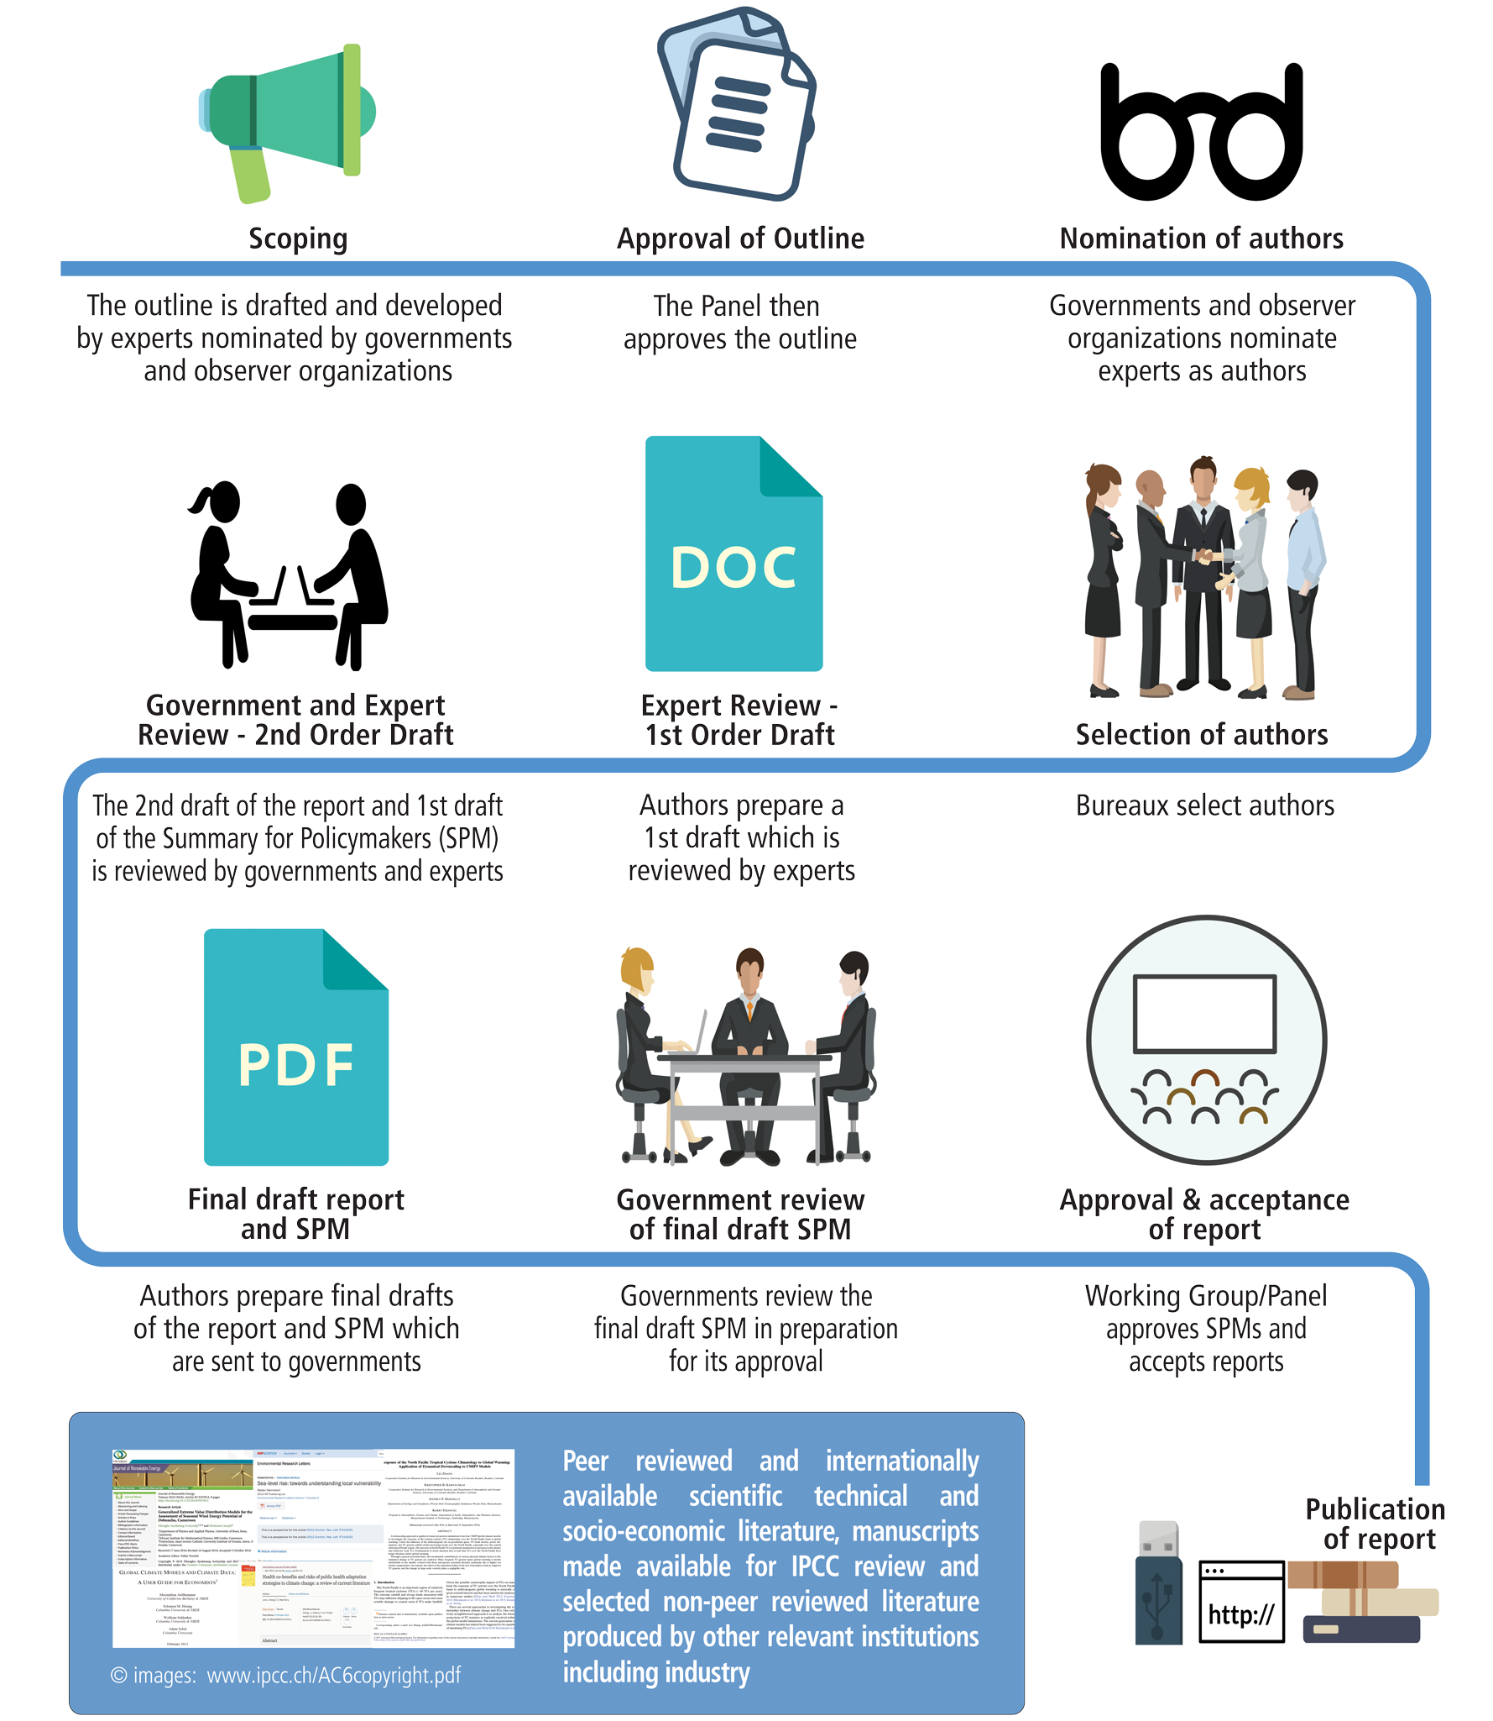

Slide 8
Observed Changes and their Causes
AR5
Human influence on the climate system is clear
Warming of the climate system is ‘unequivocal’
atmosphere and oceans warmer, amount of snow and ice diminished, sea level risen
Just under 1°C warming over past 100 years
Ocean warming has dominated increase in energy in climate system
High confidence that CO₂ intake post industrial revolution has acidified global oceans
pH decreased by 0.1 (26% increase in acidity)

Slide 9
High confidence that Greenland and Antarctic ice sheets losing mass over past 20 years; Arctic sea ice extent -4% per decrease 1980-2010
Global sea levels rose 20cm in past 100 years

Slide 10
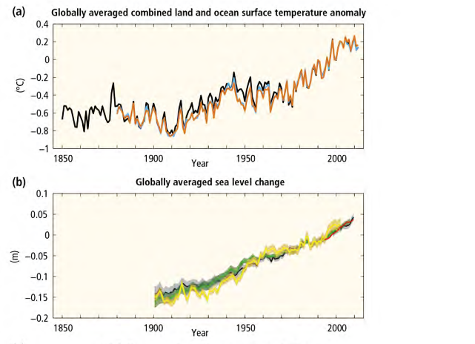
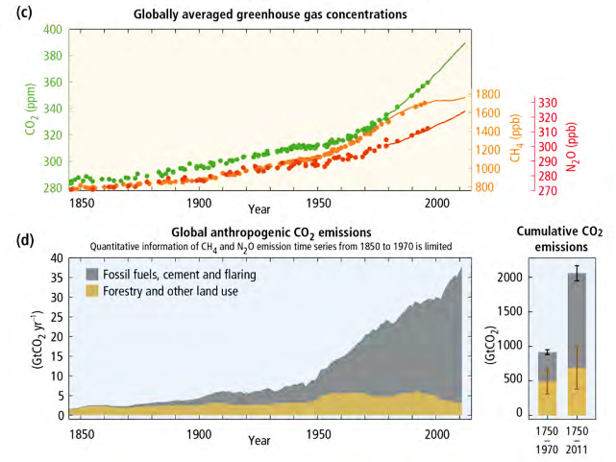

Slide 11
Extreme events:
Decrease in cold temperature extremes
Increase in warm temperature extremes
Likely that frequency of heatwaves increasing in Europe, Asia and Australia
Increase in heavy precipitation events (regional inequalities)
Likely more land regions where number of heavy precipitation events has increased than those where it has decreased.

Slide 12
Extinction of species – plant vulnerability
Even small mammals and molluscs can’t keep up with even small rise in oceanic temperature
Ocean acidification and lower oxygen levels
Coral reefs and polar ecosystems as particularly vulnerable
Delaying mitigation shifts burden from present to future

Slide 13
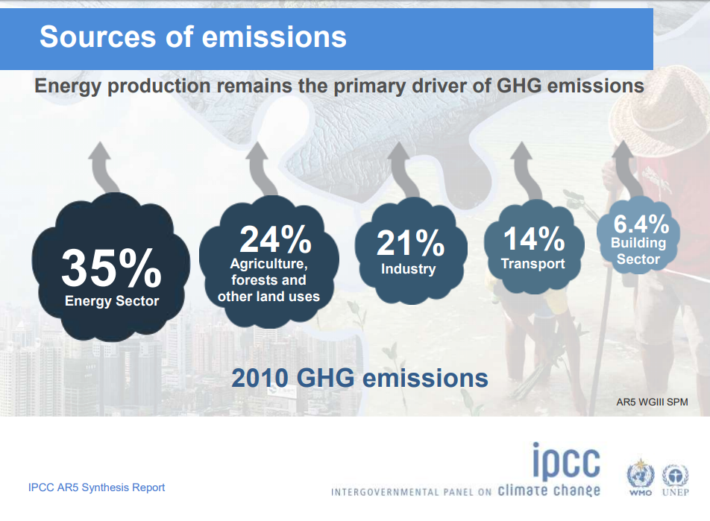

Slide 14
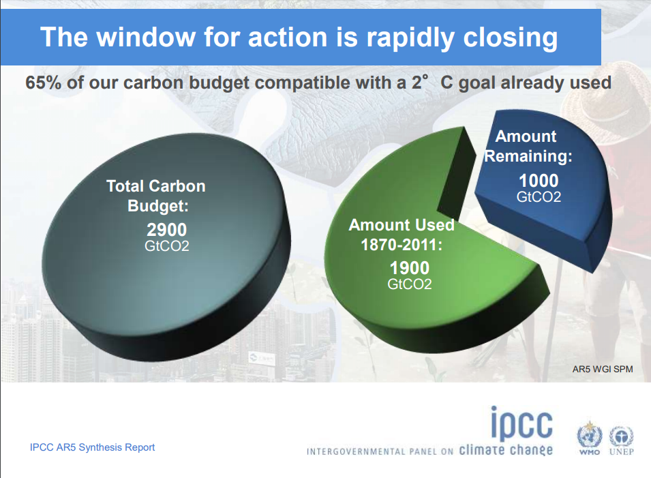

Slide 15
Predictions of AR4
1.1 to 3.2 billion people will experience increased water scarcity by 2080
Crop revenues could fall by 90% by 2100 in Africa
20-30% of species could be at risk of extinction if increases in warming >1.5-2.5°C
These expressions of risk are determined fundamentally by location in time and space

Slide 16
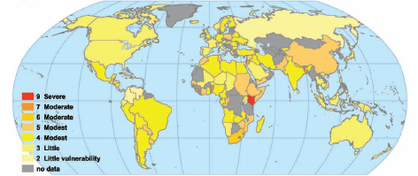
Distribution of vulnerability
Year 2050
9 Severe vulnerability
7 Moderate
6 Moderate
5 Modest
4 Modest
3 Little
2 Little
No data
Year 2100
10 Extreme
9 Severe
8 Serious
7 Moderate
6 Moderate
5 Modest
No data

Slide 17
MITIGATION

Slide 18
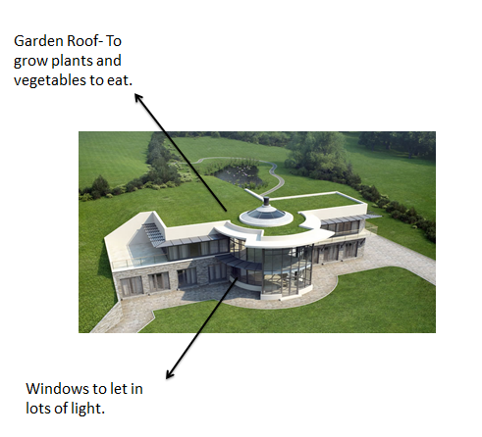
Eco house

Slide 19

Solar lantern
1.6 billion people lack access to electricity 33% live in India

Slide 20
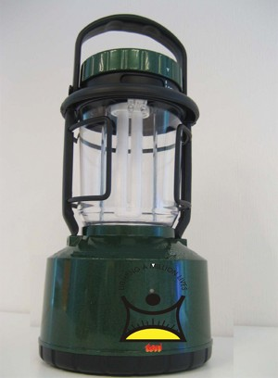
Each solar lantern:
Saves about 40-60 liters of kerosene per year
Mitigates 145 kg of CO₂ emissions per year
Alternately:
Saves about 182.5 kWh of electricity per year

Slide 21
“Bioenergy with carbon capture and storage”—BECCS.
The UN report envisions 116 scenarios in which global temperatures are prevented from rising more than 2°C.
In 101 of them, that goal is accomplished by sucking massive amounts of carbon dioxide from the atmosphere, a concept called “negative emissions”, chiefly via BECCS.
Roughly two-thirds of the corn’s carbon becomes ethanol

Slide 22
Epidemics can be predicted & prevented 2 – 3 months in advance
Adjustment of planting dates and crop variety; crop relocation; improved land management, e.g. erosion control and soil protection through tree planting
Building infrastructures

